Slide 1

Little Learner Artists
Coloring Book

Slide 2
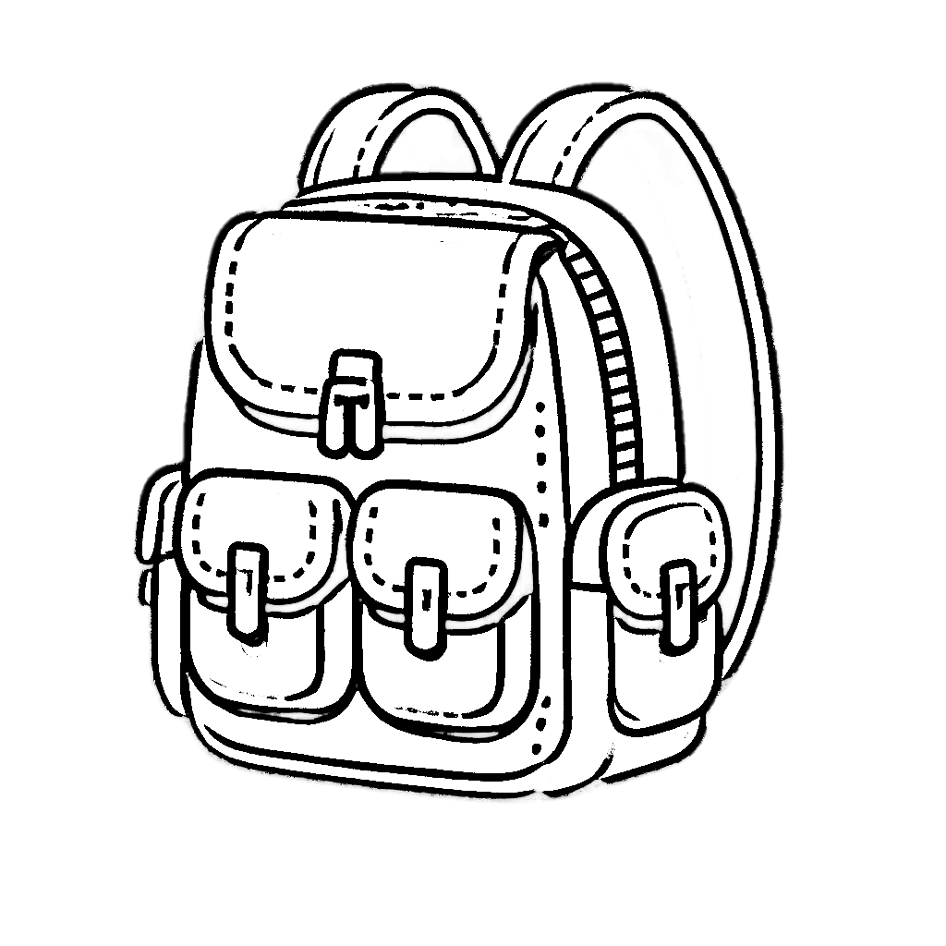
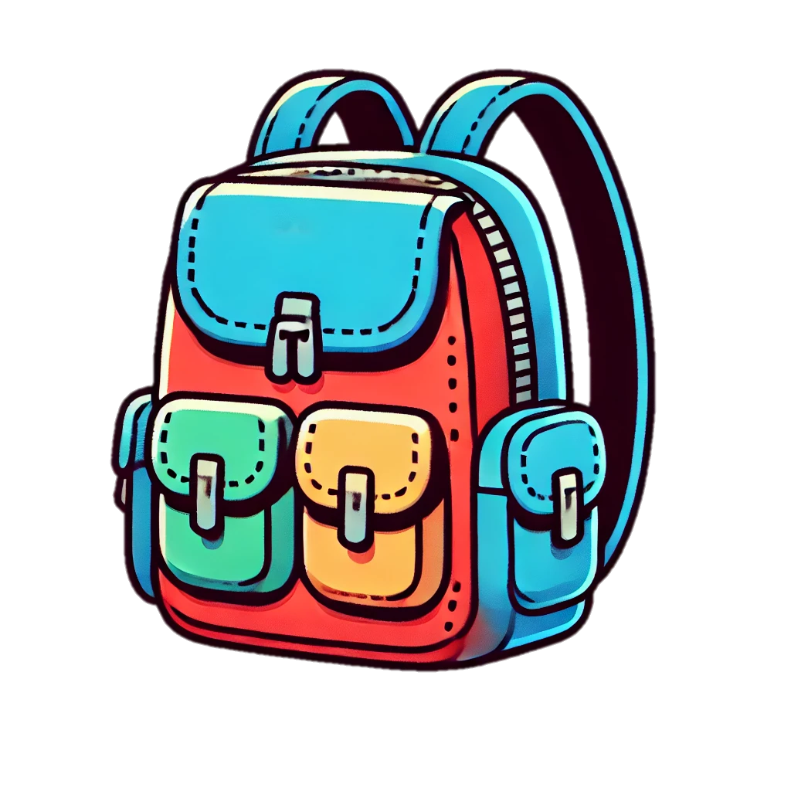
Trace & Color
My School Bag
Bag

Slide 3



Trace & Color
My School Bag
Pencil

Slide 4


Trace & Color
My School Bag
Pen

Slide 5
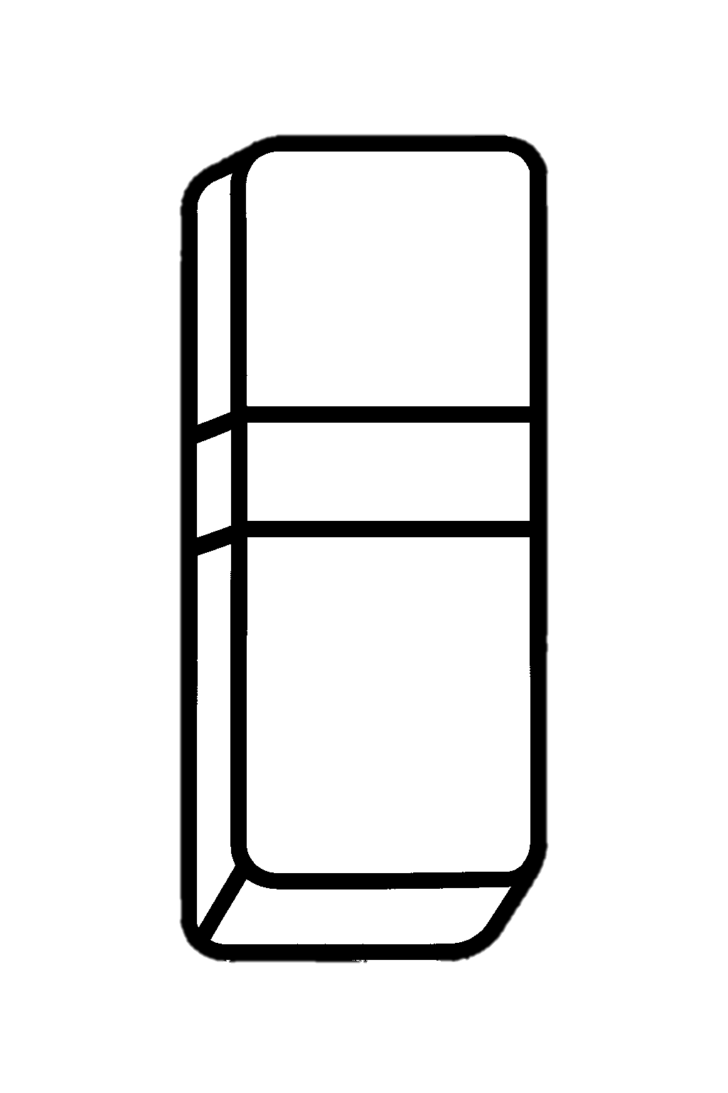

Trace & Color
My School Bag
Eraser

Slide 6

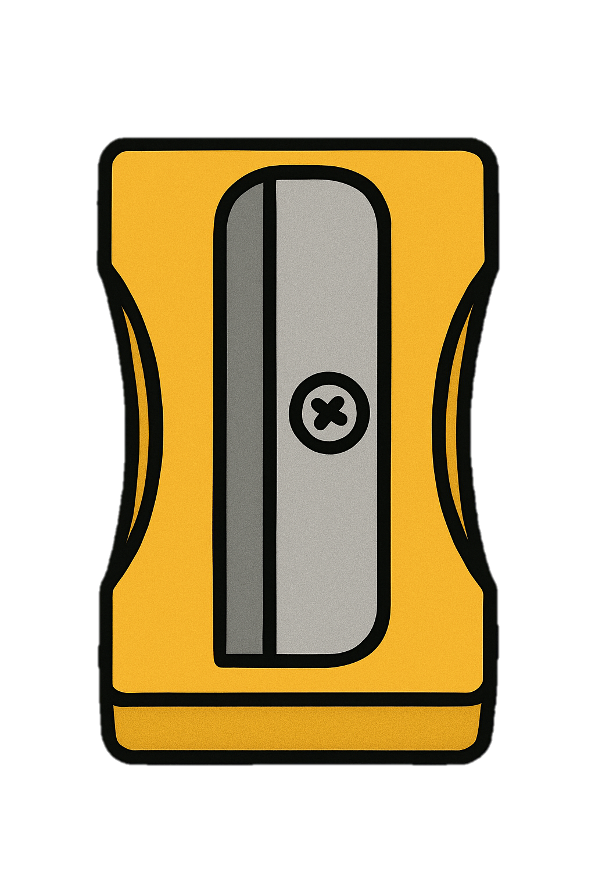
Trace & Color
My School Bag
Sharpener

Slide 7

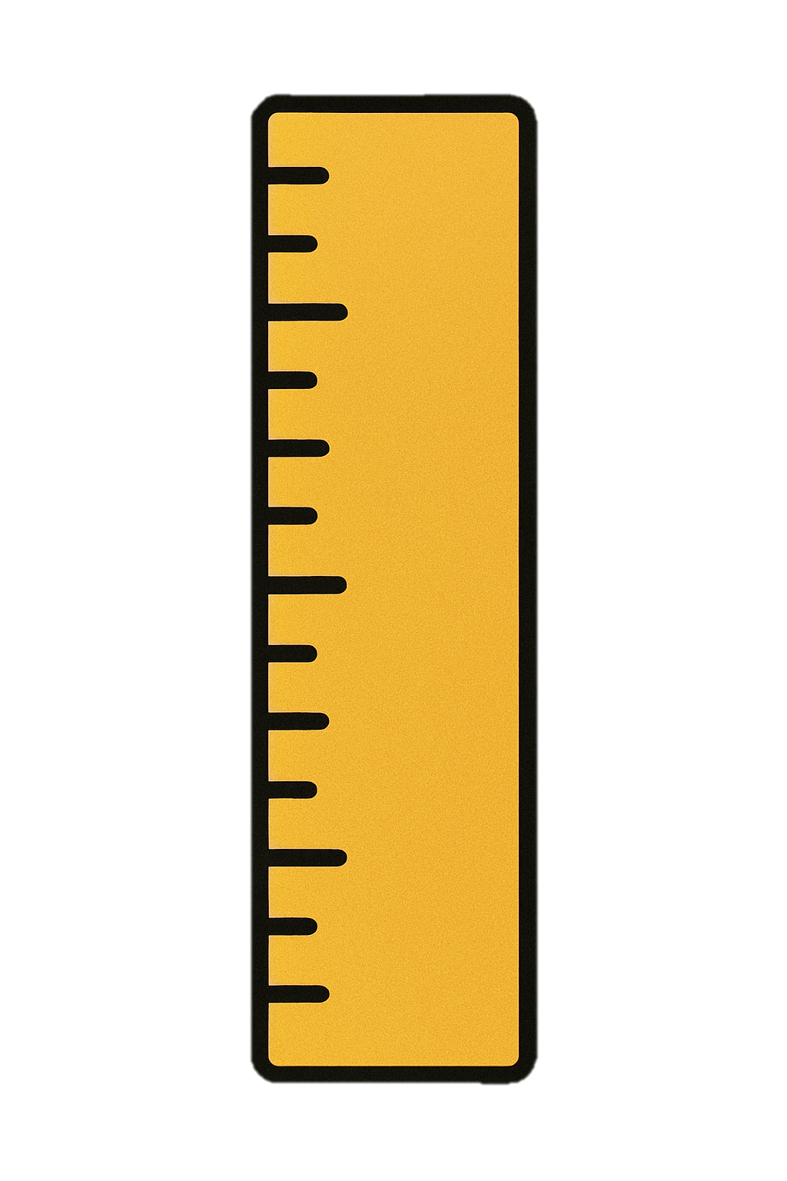
Trace & Color
My School Bag
Ruler

Slide 8


Trace & Color
My School Bag
Book

Slide 9


Trace & Color
My School Bag
Notebook

Slide 10


Trace & Color
My School Bag
Crayons

Slide 11


Trace & Color
My School Bag
Scissors

Slide 12


Trace & Color
My School Bag
Glue Stick

Slide 13


Trace & Color
My School Bag
Markers

Slide 14


Trace & Color
My School Bag
Folder

Slide 15
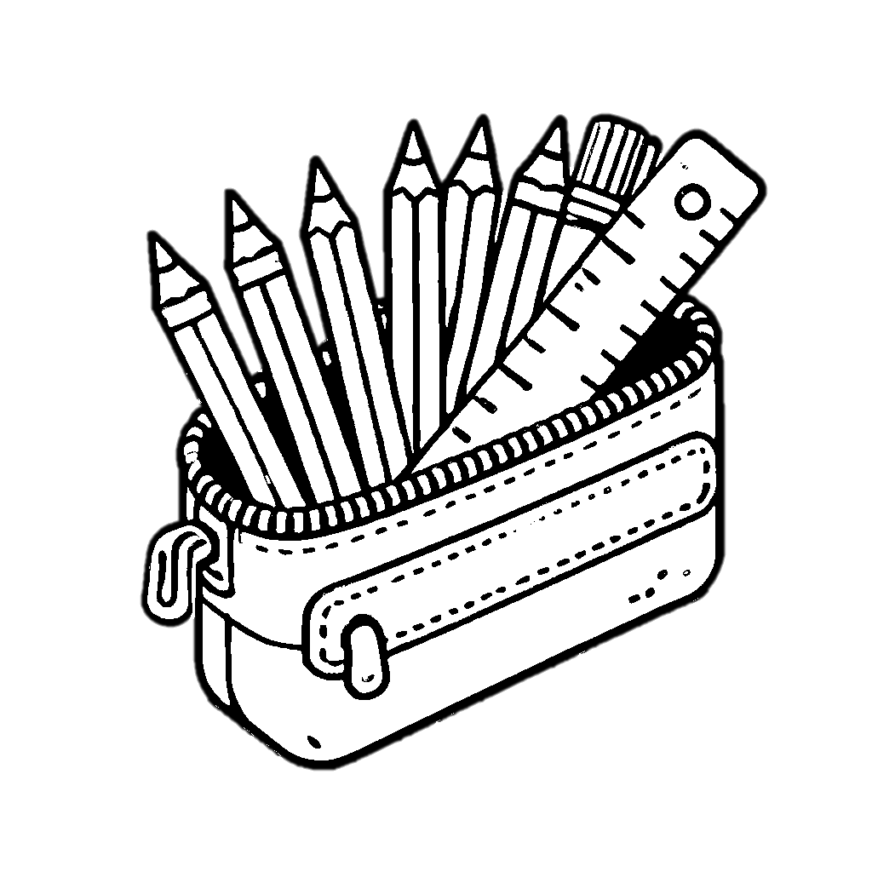

Trace & Color
My School Bag
Pencil Pouch

Slide 16
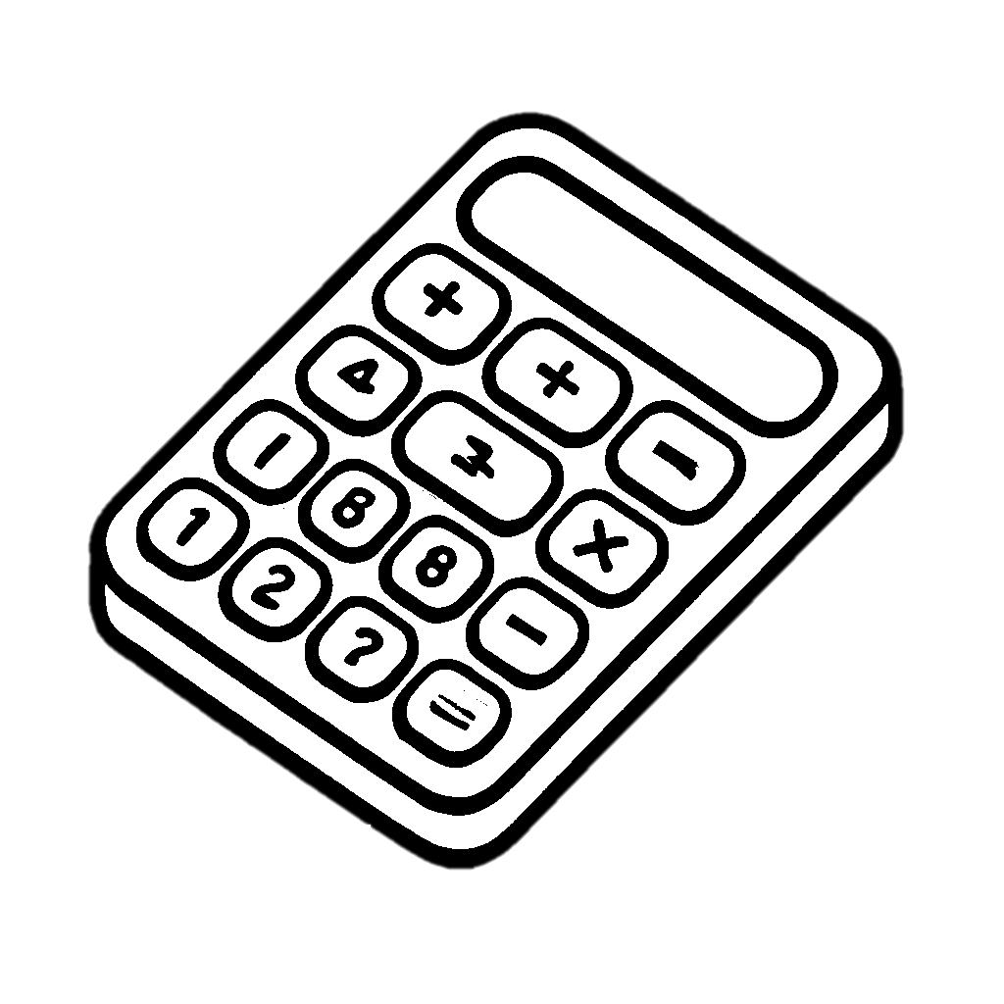
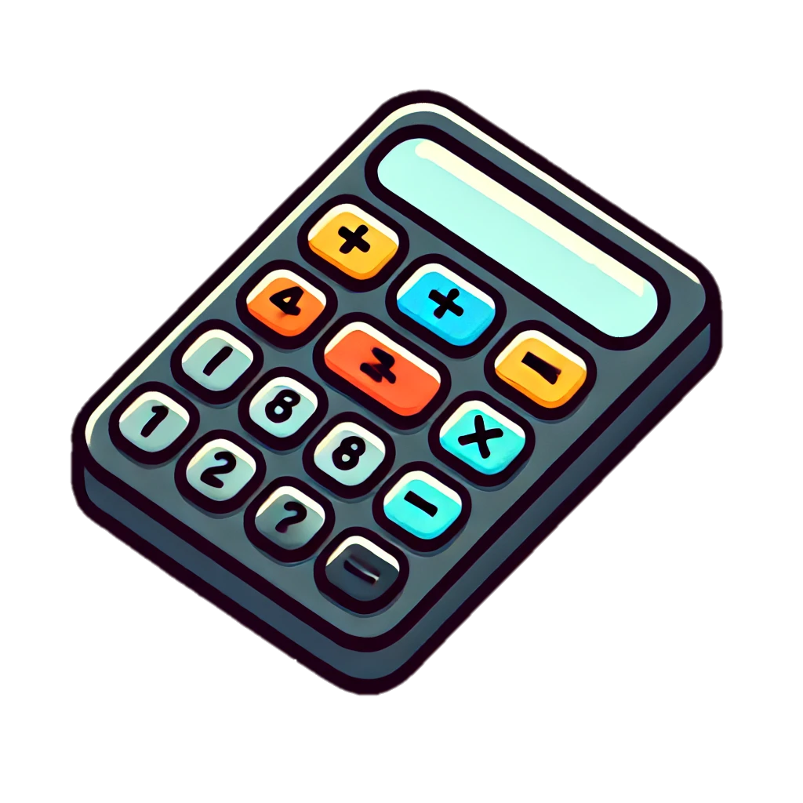
Trace & Color
My School Bag
Calculator

Slide 17


Trace & Color
My School Bag
Lunch Box

Slide 18


Trace & Color
My School Bag
Water Bottle

Slide 19
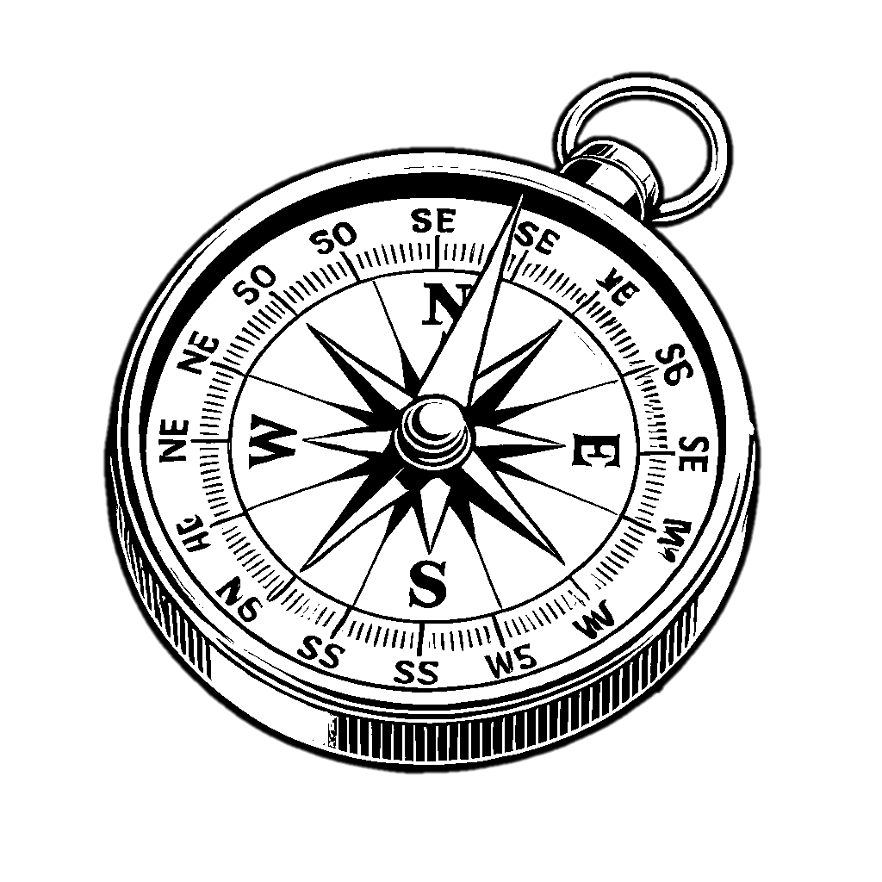

Trace & Color
My School Bag
Compass

Slide 20


Trace & Color
My School Bag
Paper Clip

